Slide 1
The abdomen
And its appendages

Slide 4
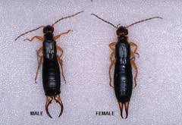

Slide 5
